Slide 1

Developing Possibility

Slide 2

Presentation Overview
Kim Hogeman – YCEA
County Authority & Programs
Upcoming / Current Projects
EPA Community Assessment Grant
Blanda Nace - City of York, Redevelopment Authority
City Authority & Programs
Upcoming / Current Projects
LERTA / ReTAP
Brendan Salyards – YCEA
York County Housing Study
Action Steps
We make things happen.
Notes:
Mission - To eliminate blight and return vacant property to productive use, thereby revitalizing neighborhoods and strengthening the tax base of the entire County of York

Slide 3
York County Land Bank Authority
7 years of Impact
50+ projects completed
Updated Demolition Grant Program
$1,980,751 granted
We make things happen.
Notes:
Mission - To eliminate blight and return vacant property to productive use, thereby revitalizing neighborhoods and strengthening the tax base of the entire County of York

Slide 4
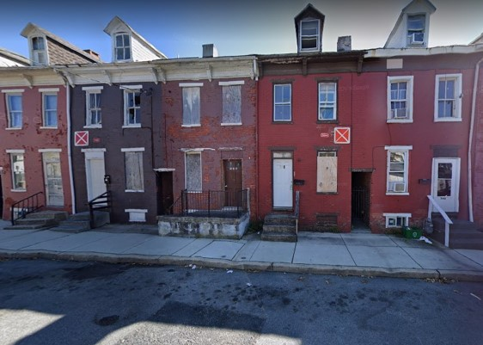
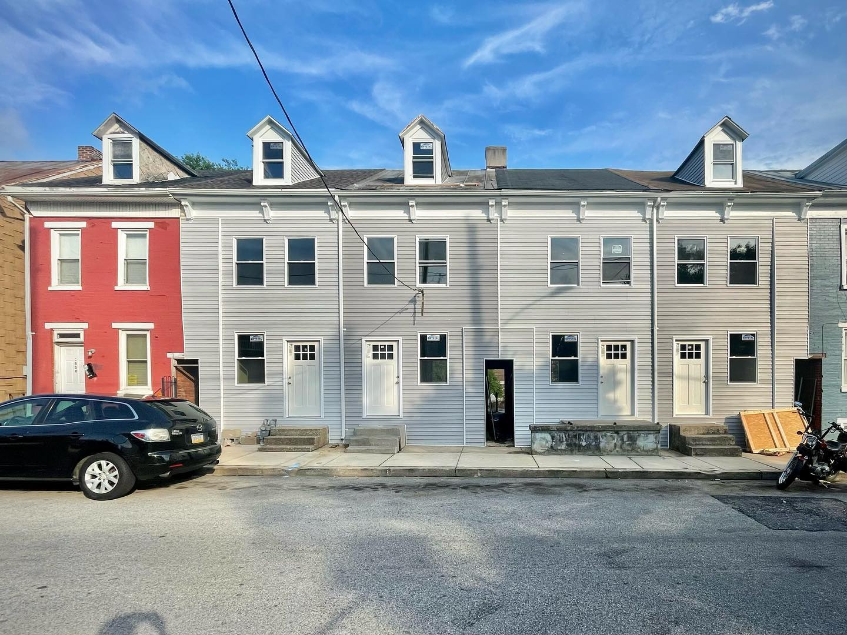
Land Bank Growth
Growing the unrestricted funding stream
Long-term planning for larger collaborative projects
Public/Private partnerships
Being pro-active in targeting blighted properties
County-wide blight assessment
Creating programs to focus on specific urban neighborhoods
Additional funding streams
We make things happen.
Notes:
Previously, only guidelines for the TT Façade program

Slide 5
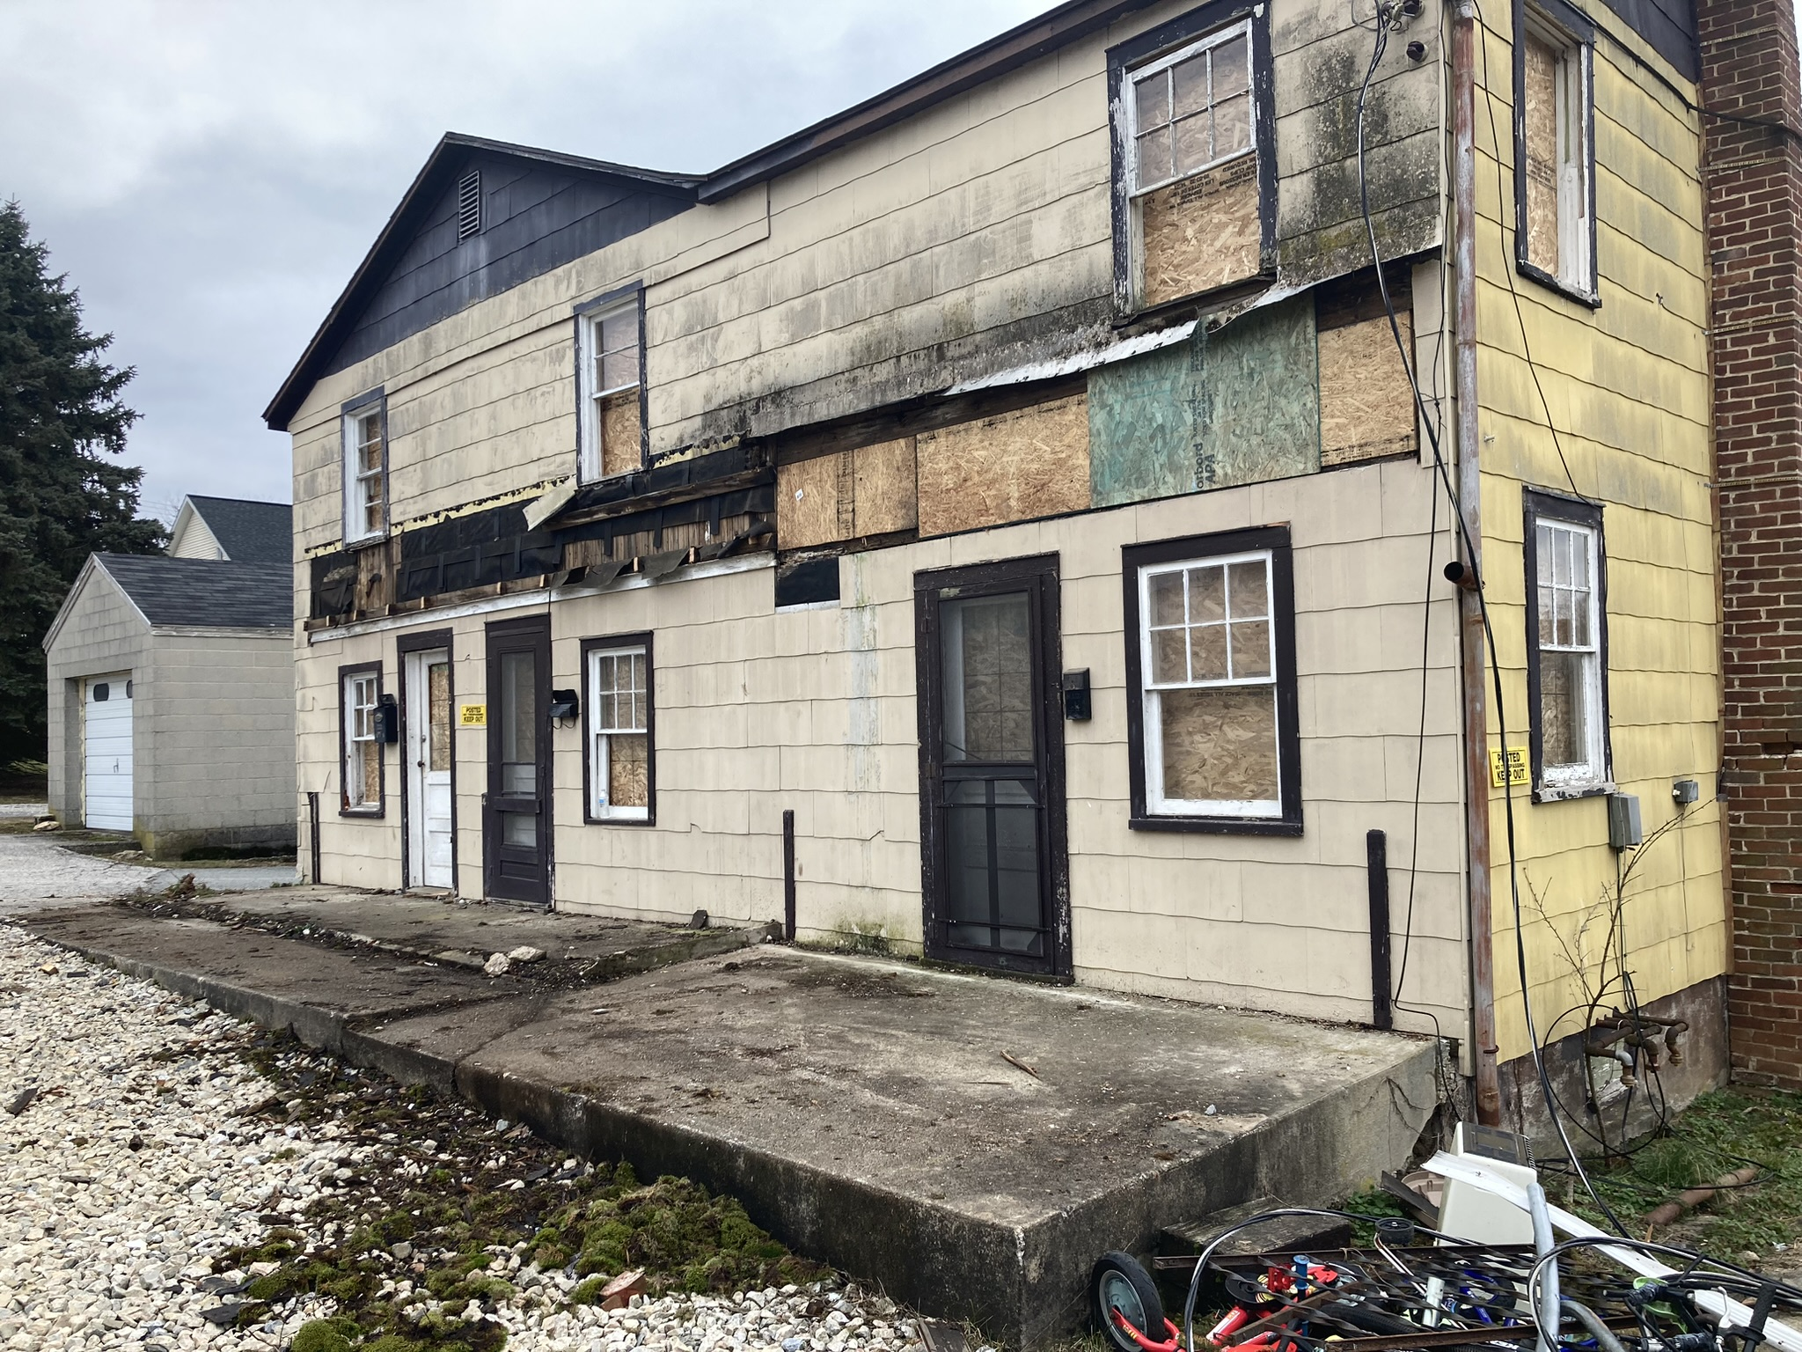
Blighted Property Review Committee
A Commissioner appointed committee with County-wide representation which through a legal and procedural process, has the ability to certify or designate a property as blighted.
We make things happen.

Slide 6
York County Industrial Development Authority
Ballpark Commons
Gateway Gardens
Zion Church Adaptive Reuse
Yorktowne (Commercial Spaces)
We make things happen.

Slide 7
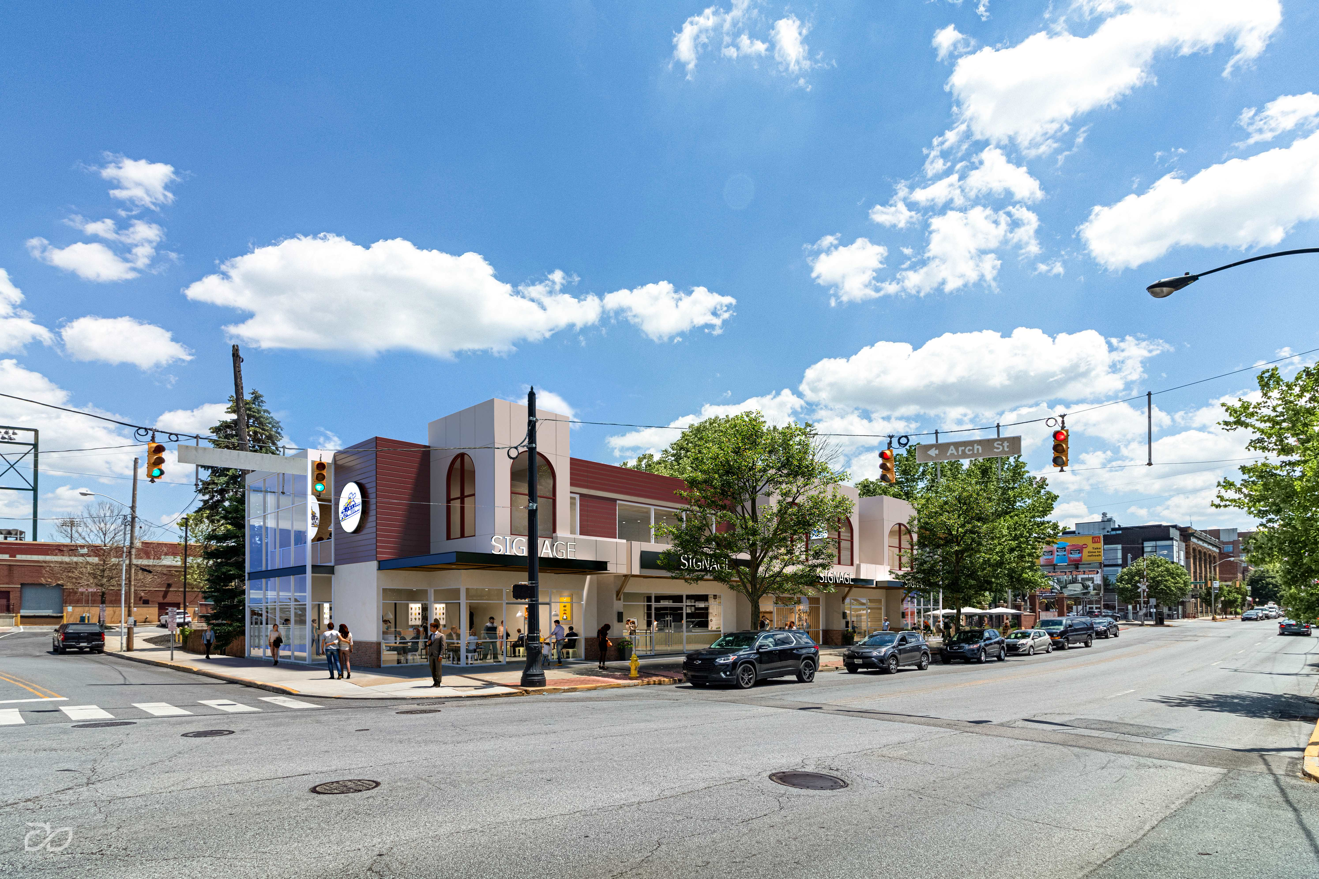
Ballpark Commons
Demo 9 blighted, vacant structures
Improve site-lines to WellSpan Park
Completes the vision of the 2005 YORC plan
$4m RACP Award
$250k LBA Grant
Development agreement signed
Construction bidding - 2026
We make things happen.

Slide 8
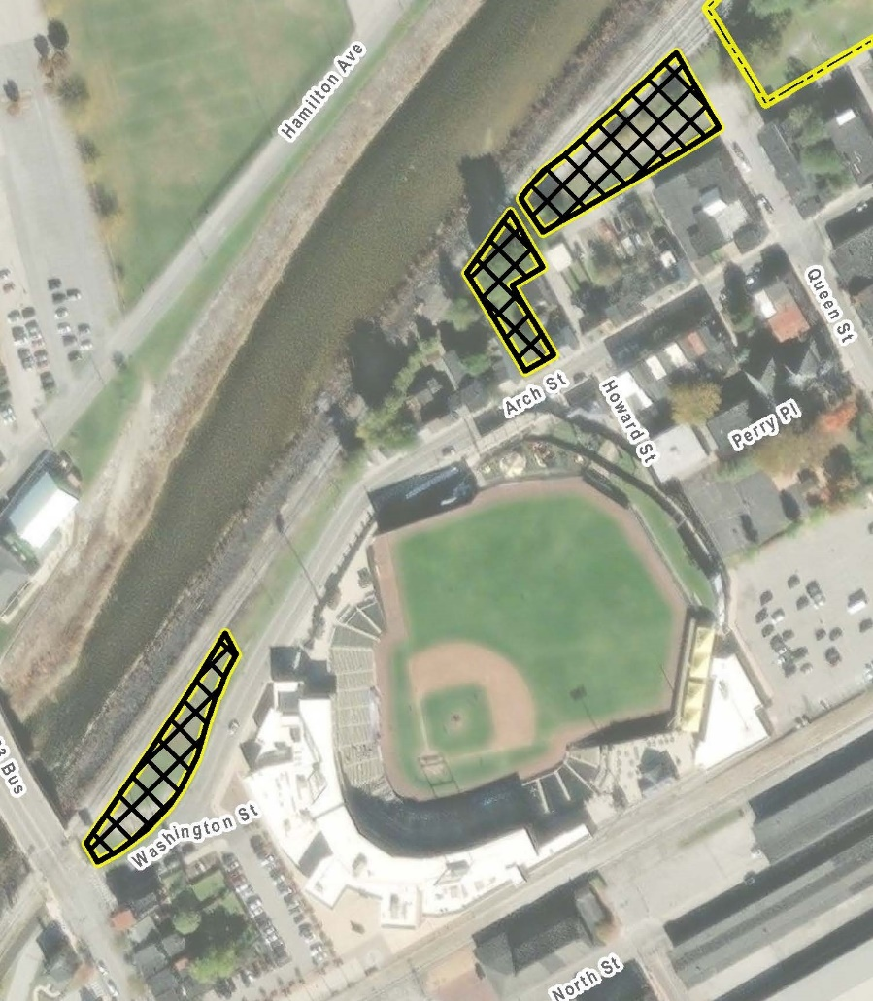
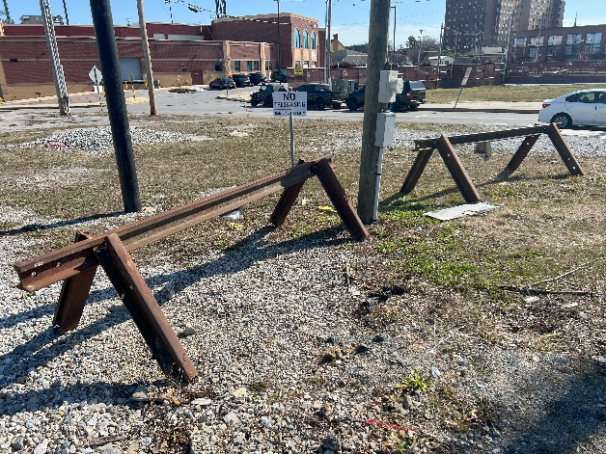
Gateway Gardens
Nuisance, unsightly property at the gateway into the City
Long-term lease secured
Native landscaping RFP
Recently awarded funding:
  Marcellus Shale Open Space Grant
  Powder Mill Foundation
  YCCF
  American Water Foundation
We make things happen.

Slide 9
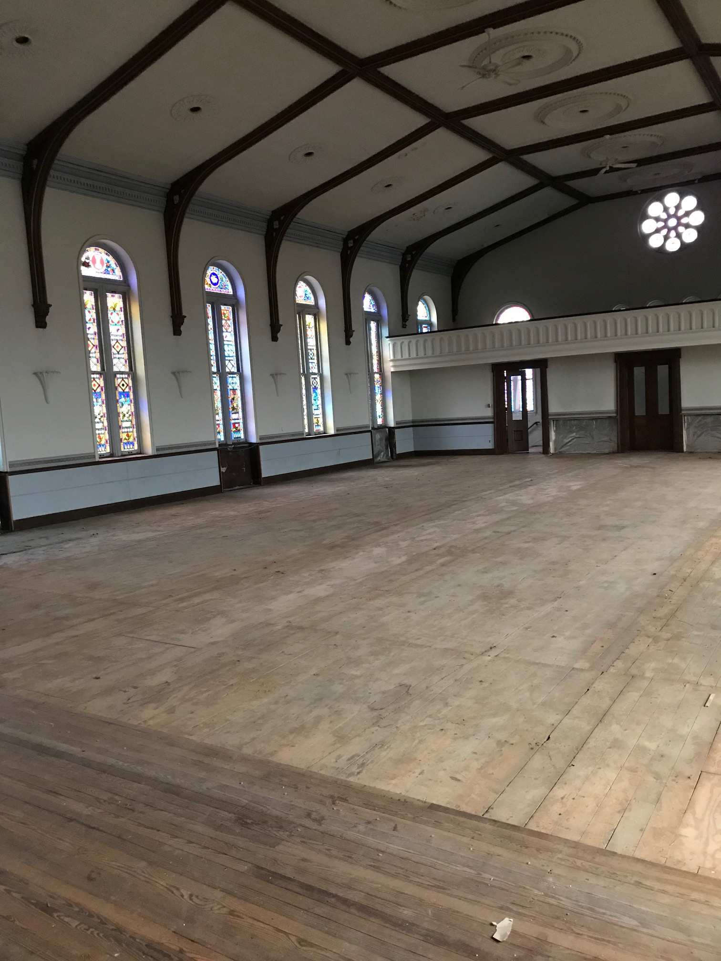
Zion Lutheran Church
Abandoned in 1995
YTH maintaining grounds
$30K A/E study complete
$505K MSM Grant for stabilization funds
$150K YCLBA Grant for demo
Next: Establish a full project scope, budget, and plan
$1M RACP
We make things happen.

Slide 10
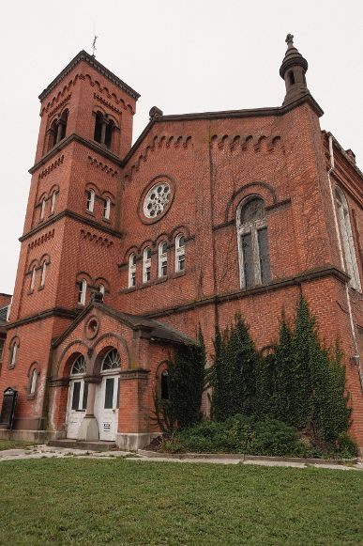
Zion – Adaptive Reuse
Event & wedding space @ YTH
Venue for larger conferences
Creative public space
Additional guest suites
Lighting the windows at night
Maintain the landscaping
Grant writing
We make things happen.

Slide 11
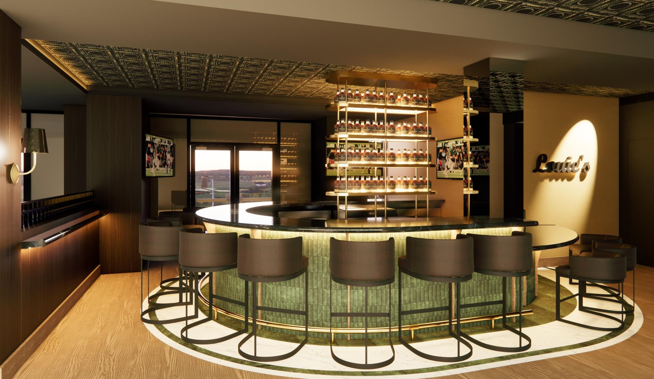
Yorktowne Hotel Commercial Space
A YCIDA project
Historically a restaurant, conceptually a steakhouse
Liquor license challenges
Street level dining
4,863 total sq/ft
Approx $2M fit-out costs
Currently fundraising
Significant F&B opportunities
We make things happen.

Slide 12
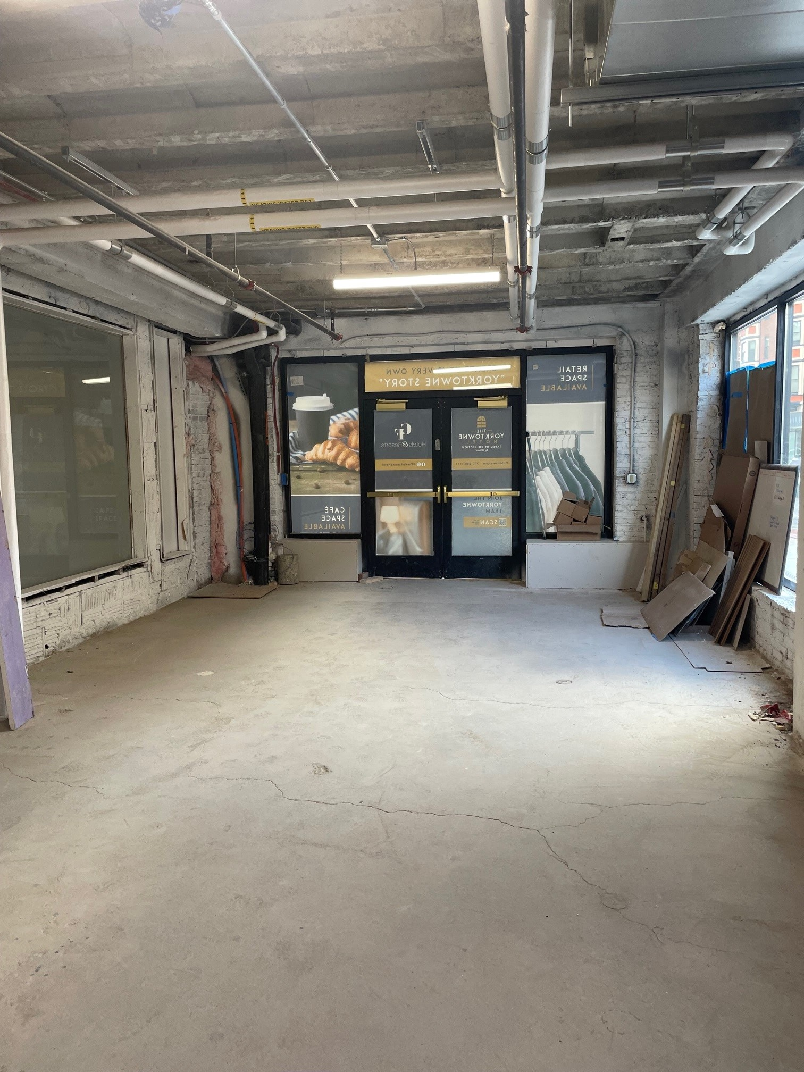
Duke Street Corner
Street level corner retail space
Lobby & Street entrances
Perfect for retail grab-n-go tourist shop
Approx $400k in fit-out costs
Approx 730 sq/ft
Currently storage
We make things happen.

Slide 13
Redevelopment Authority of the County of York
Codorus Greenway
Glen Rock Ruins Plaza
EPA Community Assessment Grant
Project Opportunities
We make things happen.

Slide 14


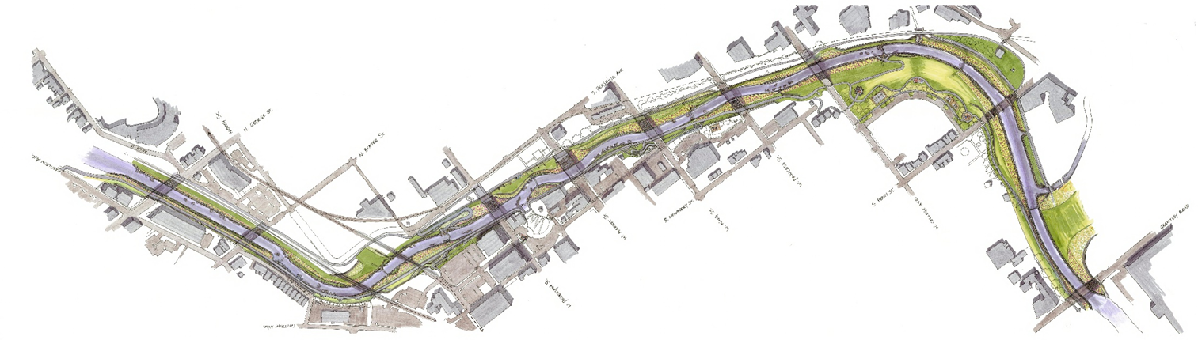
Codorus Greenway
Campus Door
WellSpan Park
Agricultural & Industrial Museum
York Academy Lower School
Riverview Lofts
Keystone
Kidspace
York County History Center
Knowledge Park &
JD Brown Center
Heritage Crossing
York Academy Upper School
Bascule Gate Dam Removal
Logos Academy
Homes at Thackston Park
TechRev York
Penn Market
Dentsply Property
We make things happen.

Slide 15
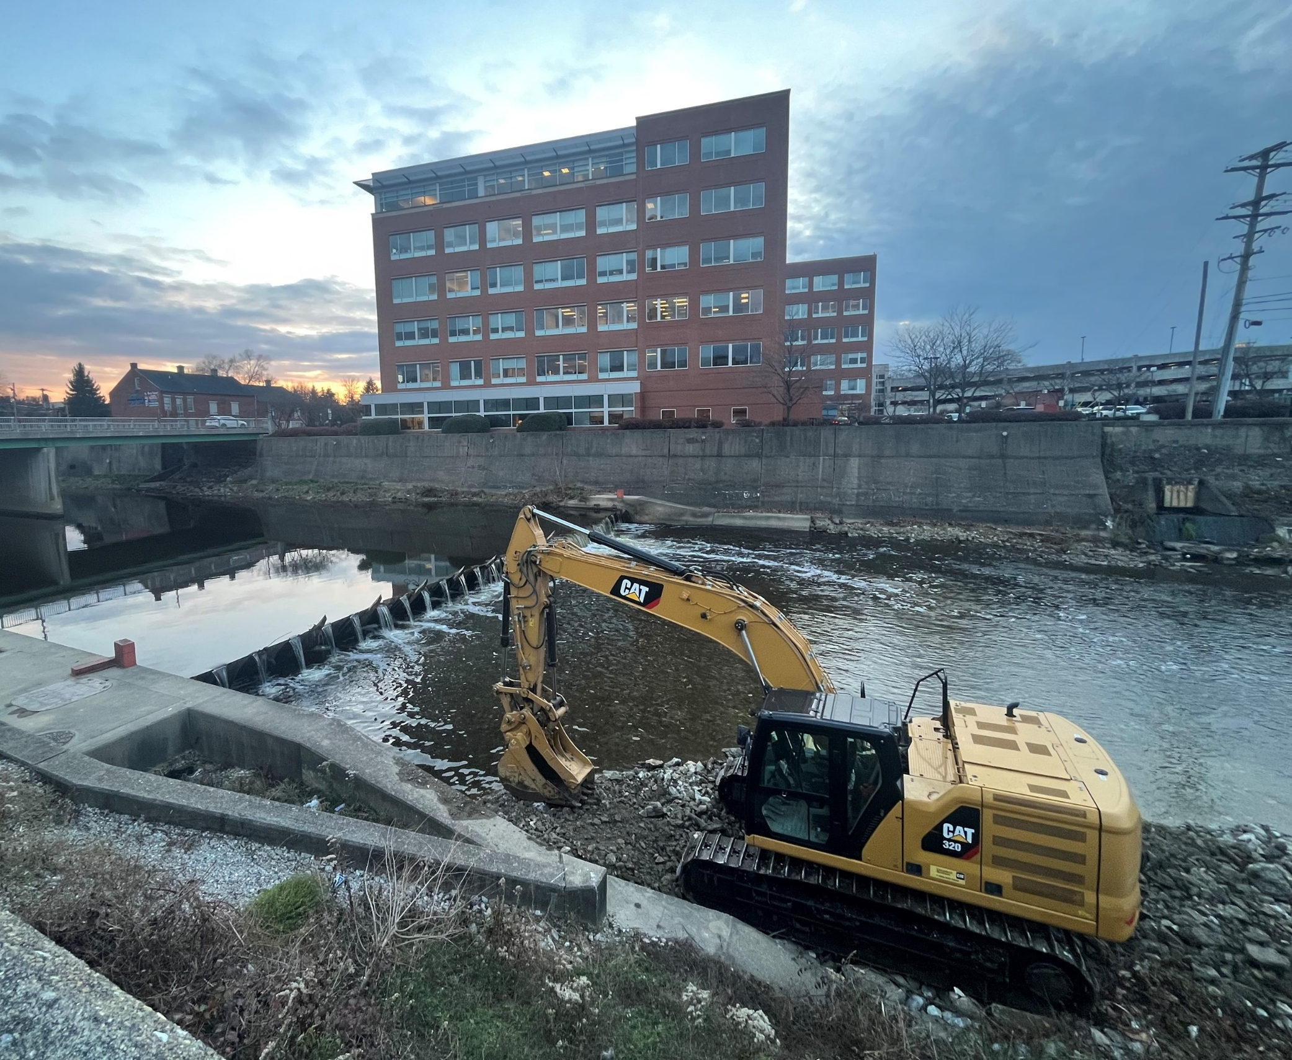
Next Steps
A YCEA & RACY Project
Phase I: Grantley to College Ave., Hartley to Foundry Plaza
Phase 1 $40+M
Funding needed: Interest, Phase 2, and for Market St. Bridge
$550K for Bascule Gate Dam Removal (complete)
Submitted joint permit package to USACE in Q4 of 2024
Construction Bidding Q1 2026
We make things happen.
Notes:
$20m in RACP
$15m in RAISE
Phase 1 $35-$40m
Joint Permit Submitted Q4 2024
Permit – comment period
Bid in Q4 2025
West side – foundry plaza to College
College to Grantly – both sides

Slide 16
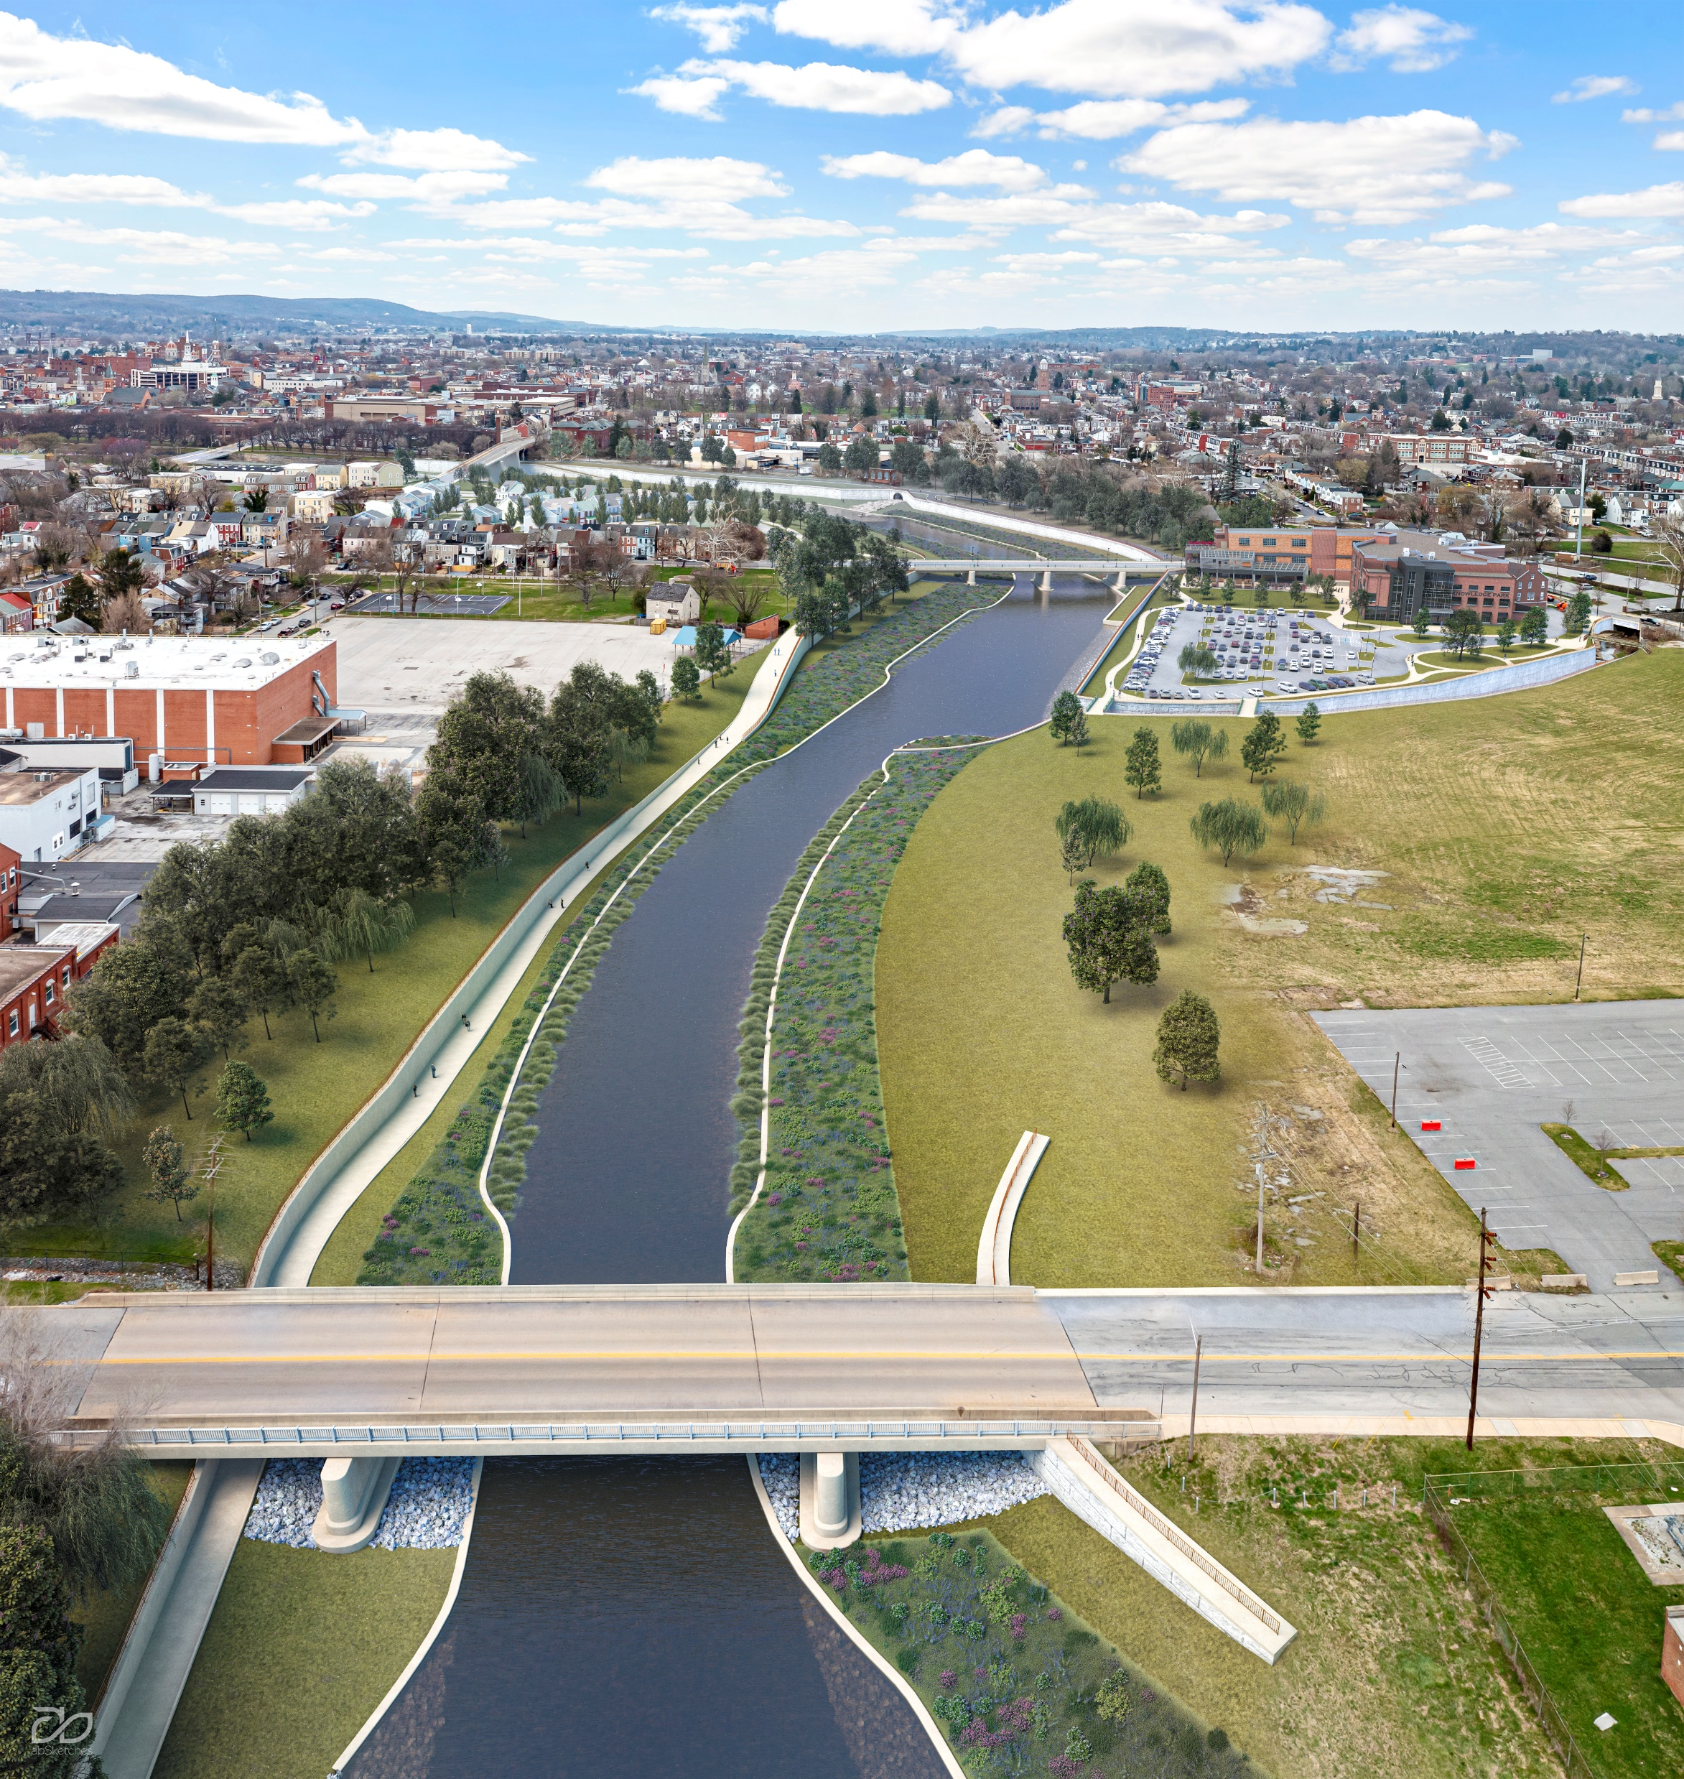
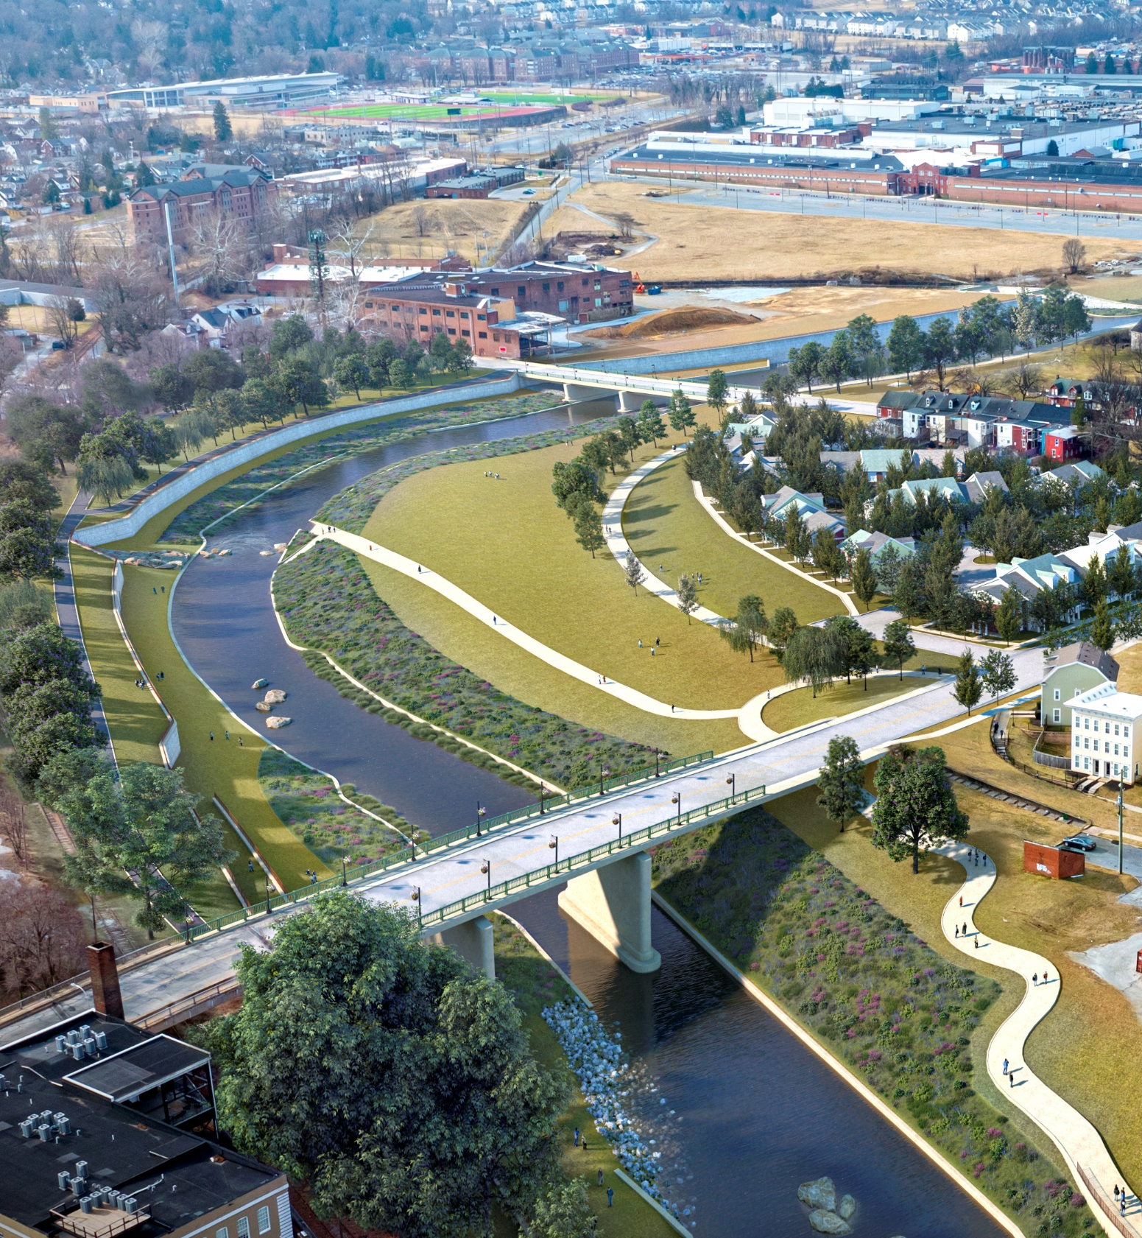
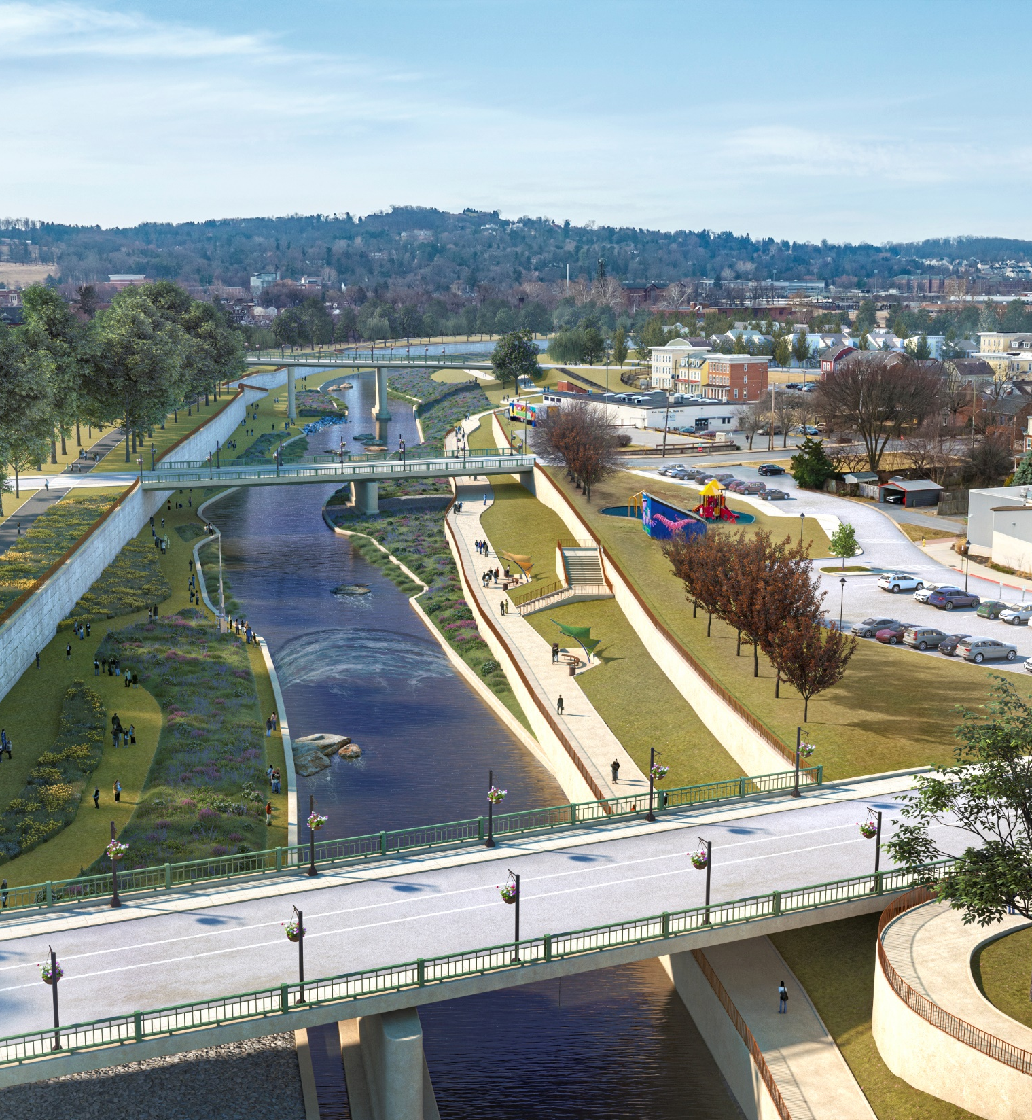
We make things happen.
Notes:
Grantley & Penn
Dentsply on left, YCP Knowledge Park on right
W College Ave, view of Thackston Homes, Penn & YCP
Philadelphia Street (YCHC to the left, Susq Commerce to the right)

Slide 17
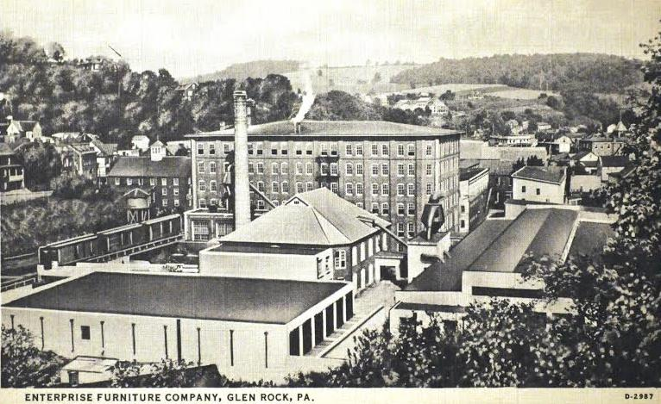
Ruins Hall Plaza, Glen Rock
A Glen Rock Borough & RACY project
Estimated investment $2M
RACP $1M
Warehime $500K
PMF $500K
Next Steps: Finalize design, bidding & construction 2026
We make things happen.

Slide 18
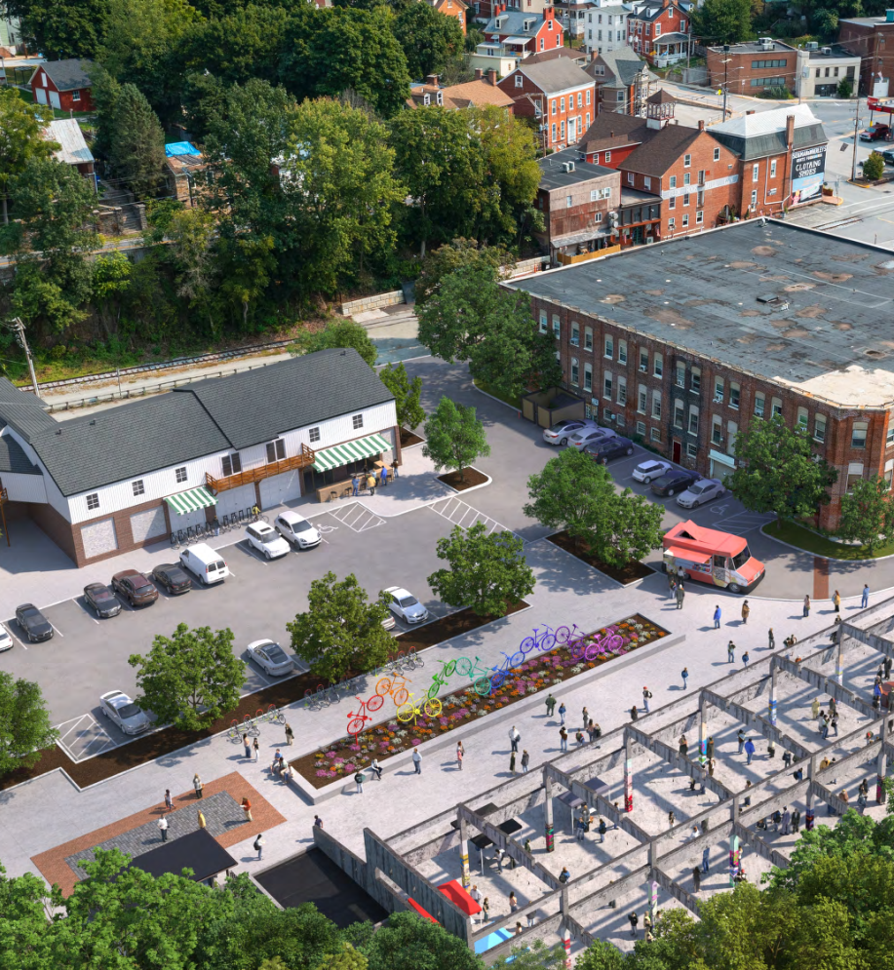
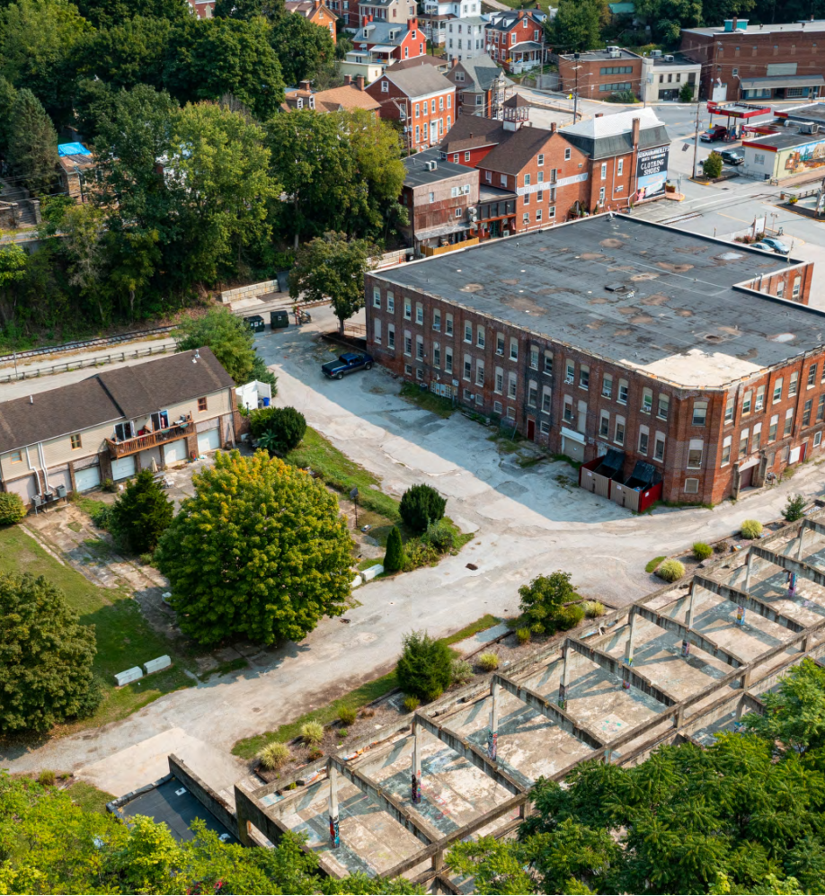
We make things happen.

Slide 19
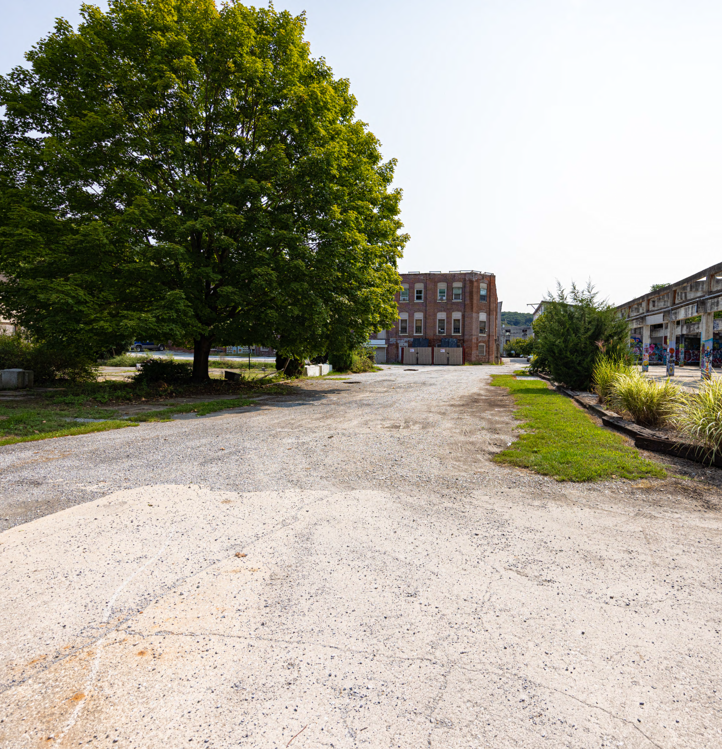
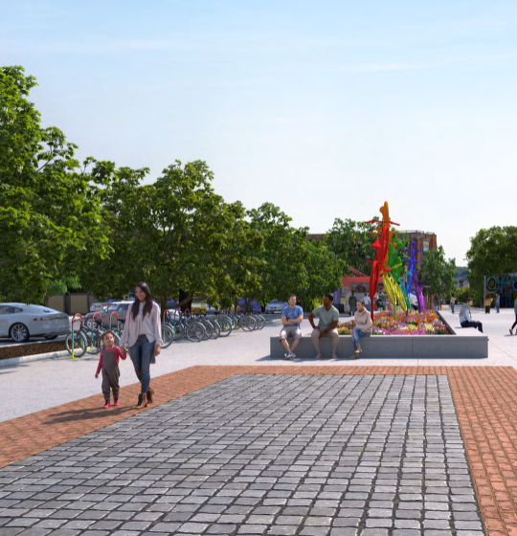
We make things happen.

Slide 20
Upcoming Brownfield Initiatives
A RACY Initiative
EPA Community Assessment Grant
RFP for Assessment Activities
4-Year Timeline
Activities
  Phase I & II
  RBM Surveys
  Site-Specific Sampling
  Planning Activities
We make things happen.

Slide 21


The Redevelopment Authority of the City of York
BACKGROUND:
Five Board Members and One Staff
Michael Black – Chair
Frank Countess
Joyce Santiago
Hannah Beard
Melissa Rosario
Blanda Nace – Executive Director & Secretary
Don Hoyt, Solicitor

Slide 22
RDA Property Transactions
In the past 5 years, the RDA has returned
$3.3 Million value to tax rolls
This represents City Tax revenue of $62,550 annually
(School Tax Revenue is $121,203 and County is $4,458)
The RDA Currently has NO STRUCTURES for sale
NOTE: These values do NOT represent future increases in assessments from projects such as the Northwest triangle and Dentsply Campus

Slide 23
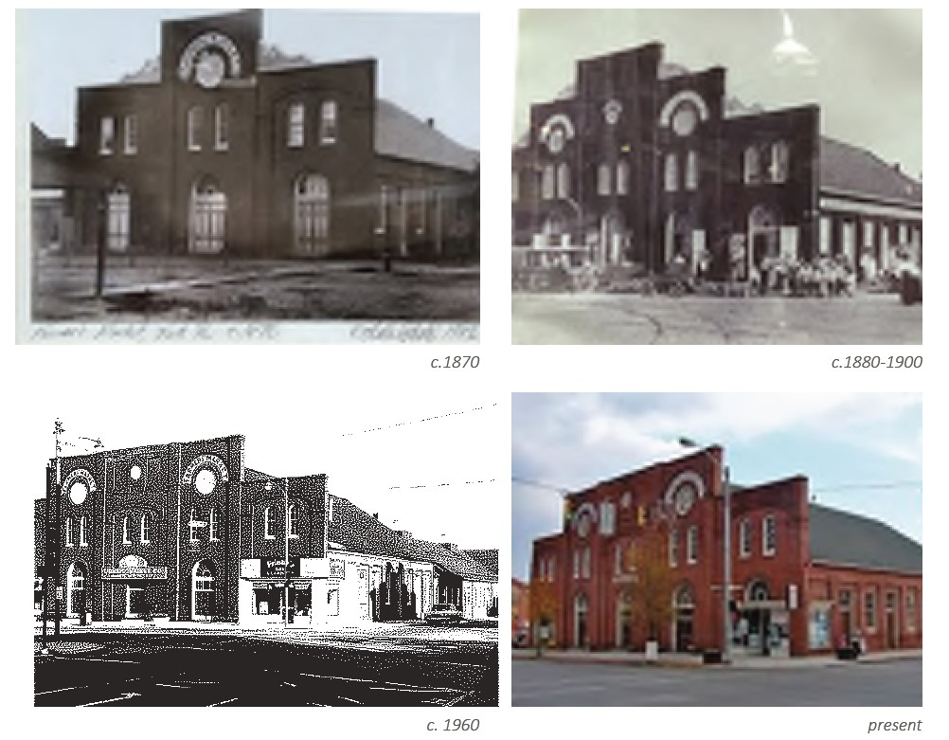
Redevelopment Authority of the City of York
Penn Market

Slide 24
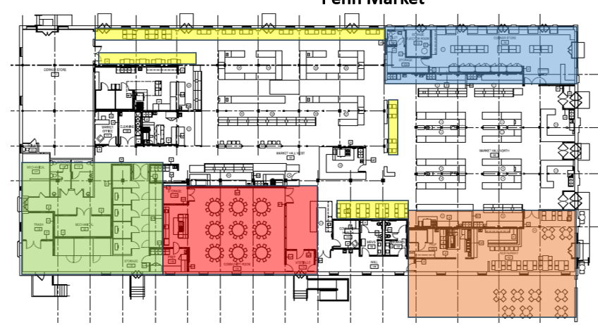
Redevelopment Authority of the City of York
Penn Market
Scattered Customer Seating
Improved Corner Store with Market Connection
Back of House with Vendor Storage & Prep
Community Room with Demonstration Kitchen
New Restaurant with Outdoor Seating

Slide 25
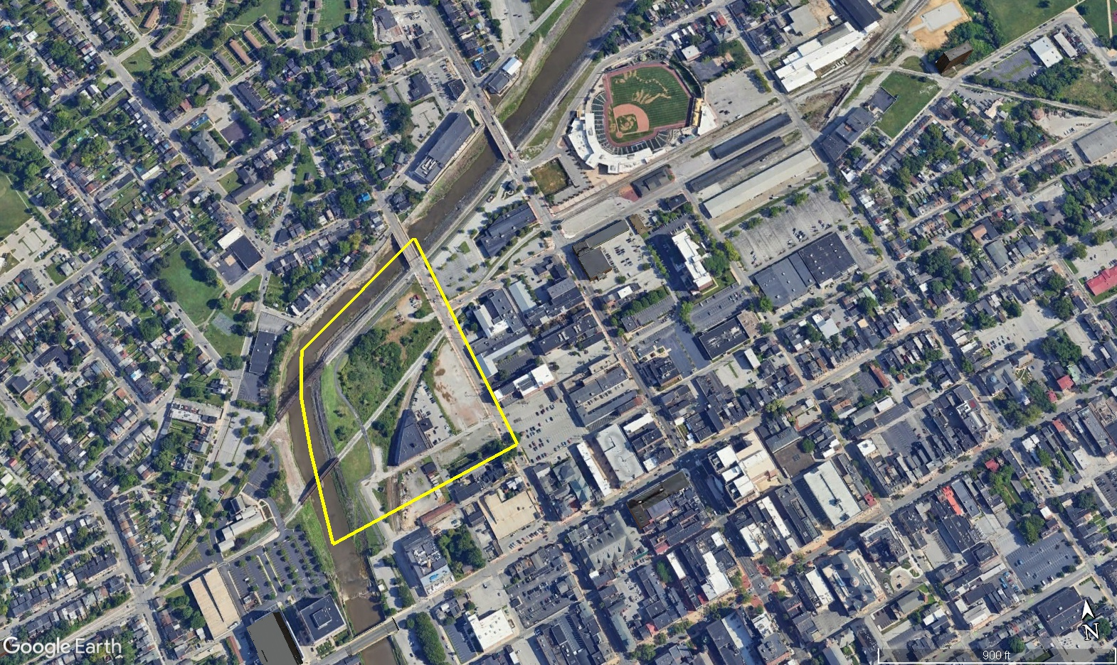
Redevelopment Authority of the City of York
Northwest Triangle – Heritage Crossings

Slide 26
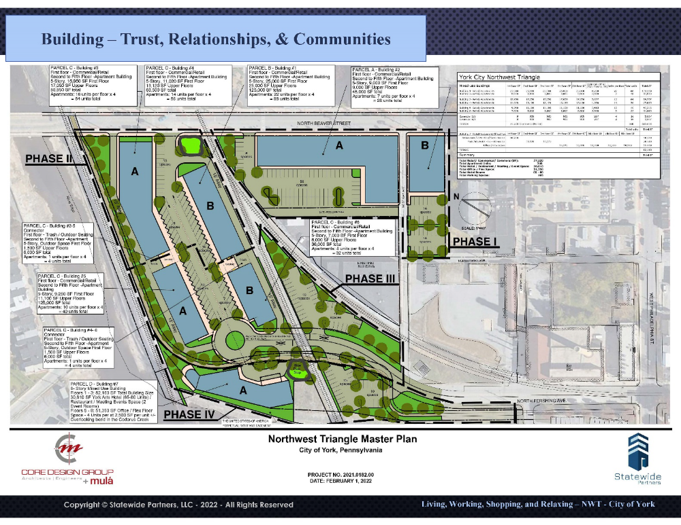
Redevelopment Authority of the City of York
Northwest Triangle – Heritage Crossings
Statewide Partners
3-4 Phases 5-7 Buildings
77,000 SF Commercial
340+ Apartments
50,000 SF Office/Flex/Event Space

Slide 27
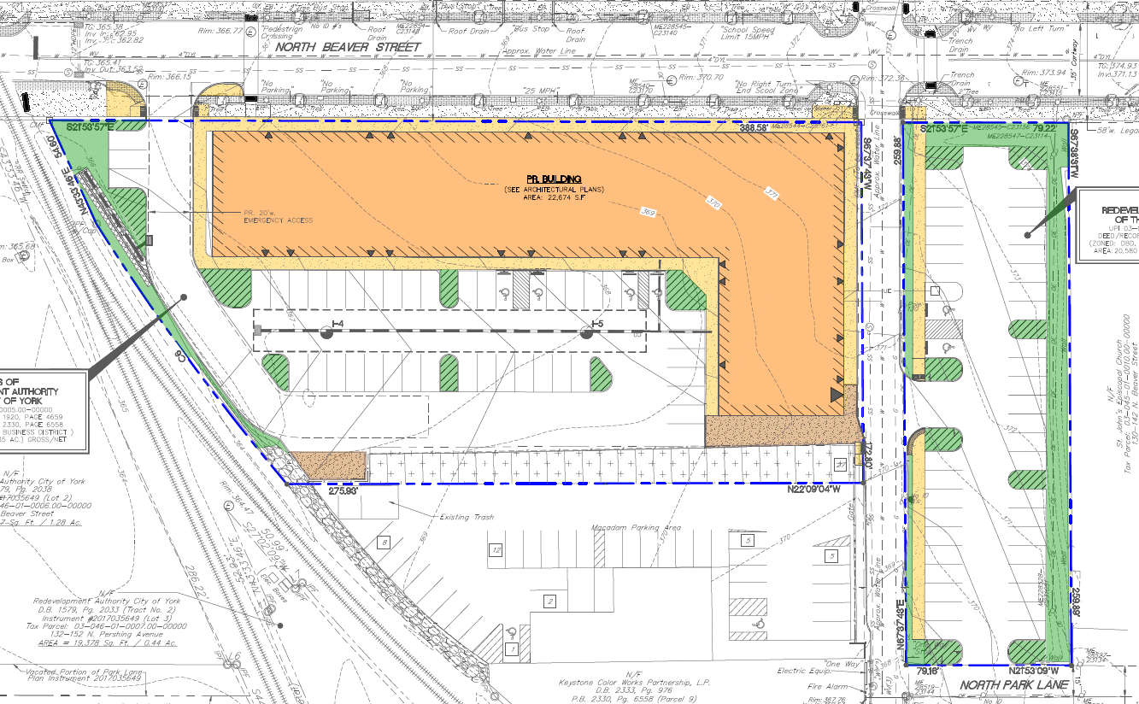
Redevelopment Authority of the City of York
Northwest Triangle – Heritage Crossings
Statewide Partners
Phase I – NOW
139 Apartments
20,000 SF Retail 1st Floor
6.5 Story Height

Slide 28
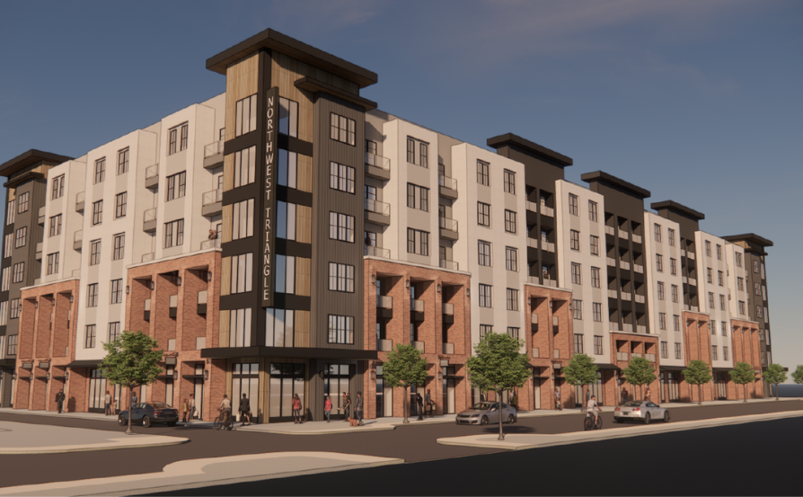



Redevelopment Authority of the City of York
Heritage Crossings

Slide 29
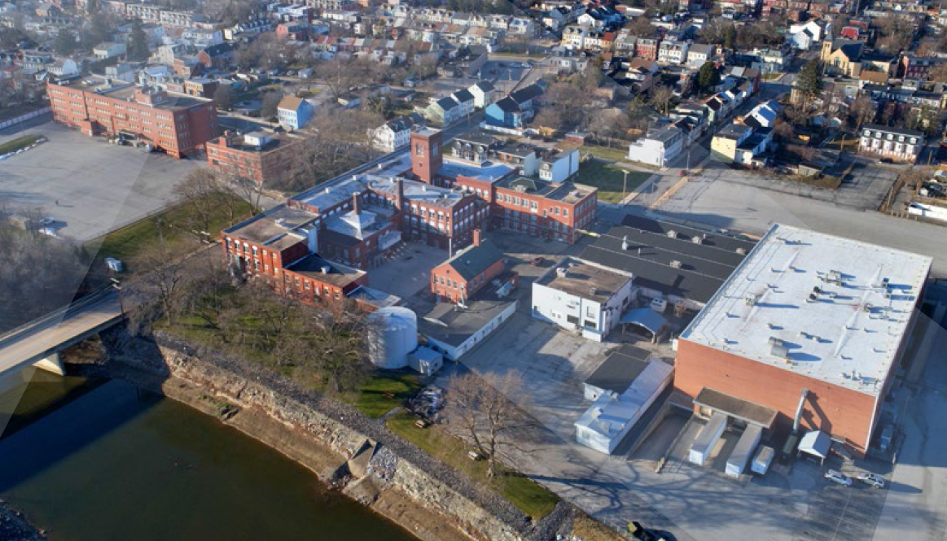
Redevelopment Authority of the City of York
Dentsply Campus

Slide 30
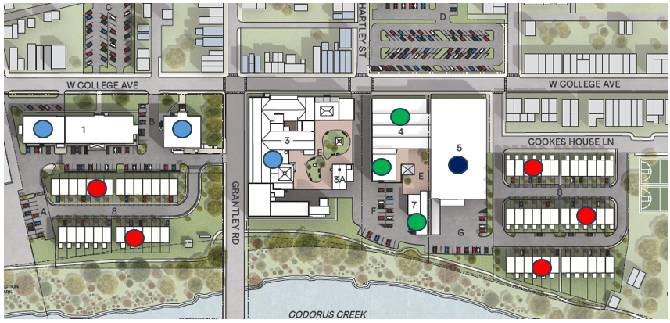
Redevelopment Authority of the City of York
Dentsply Campus
178 Workforce Apts.
29,000 SF Retail Space
100,000 SF Storage
62 Townhomes

Slide 31
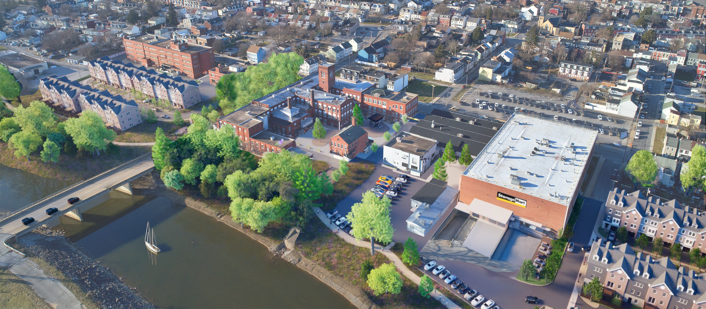
Redevelopment Authority of the City of York
Dentsply Campus

Slide 32
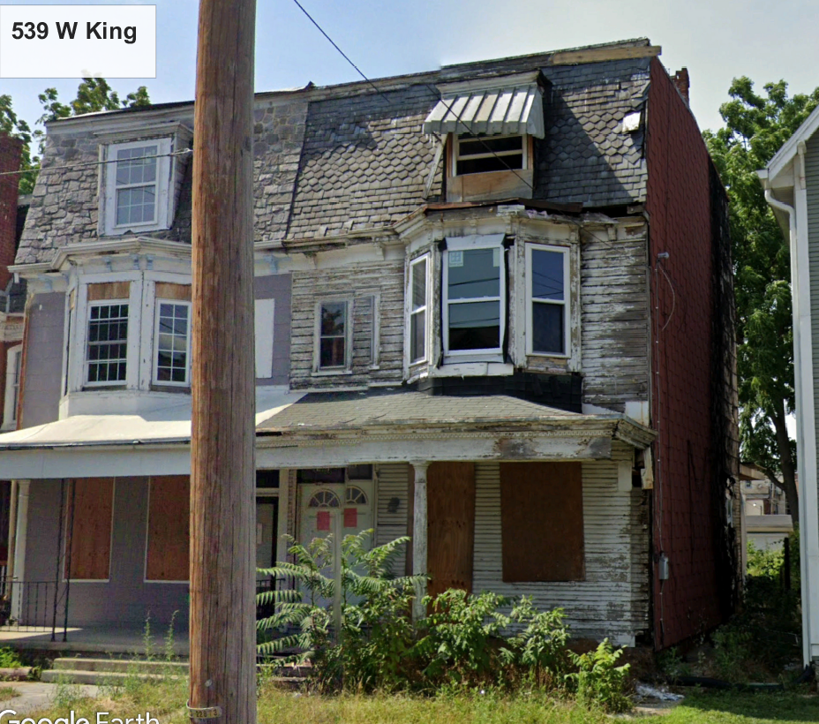
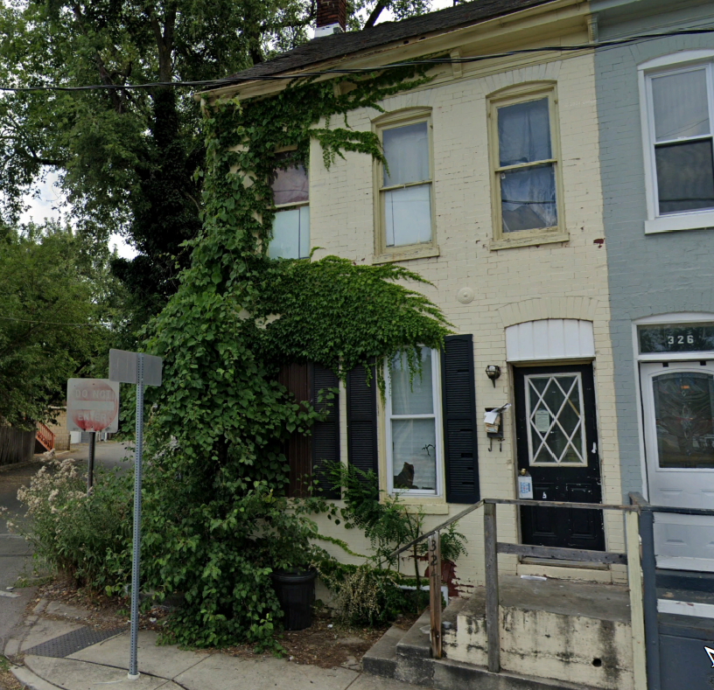
Redevelopment Authority of the City of York
Blighted Property & Vacant Lot Redevelopment
539 W King
324 Smith

Slide 33
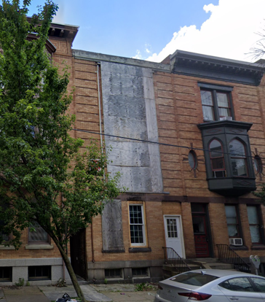
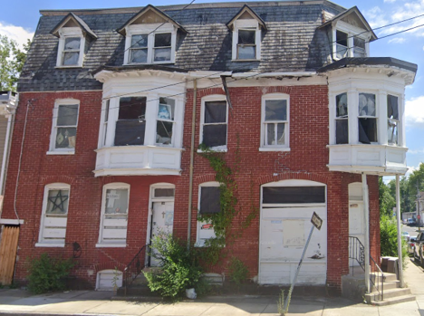
Redevelopment Authority of the City of York
Blighted Property & Vacant Lot Redevelopment
144 E Philadelphia
590 Salem Ave

Slide 34
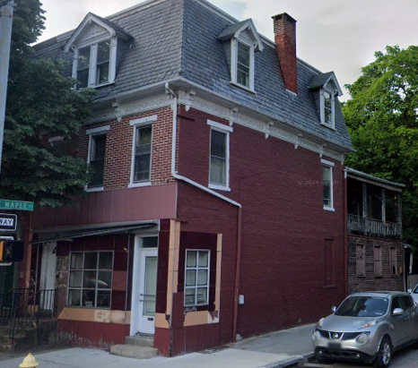
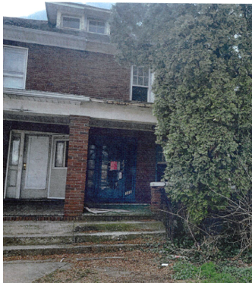
Redevelopment Authority of the City of York
Blighted Property & Vacant Lot Redevelopment
455 S George
312 W Jackson

Slide 35
Redevelopment Authority of the City of York
Blighted Property & Vacant Lot Redevelopment
FUTURE PLANS
Redevelop Blighted Properties as identified by City
Create sustainability for the Authority
Facilitate / Engage in Larger Redevelopment Projects

Slide 36

City of York
Development Incentives
Vision
Opportunity Zones
Commercial Tax Abatement (LERTA)
Residential Tax Abatement (ReTAP)

Slide 37
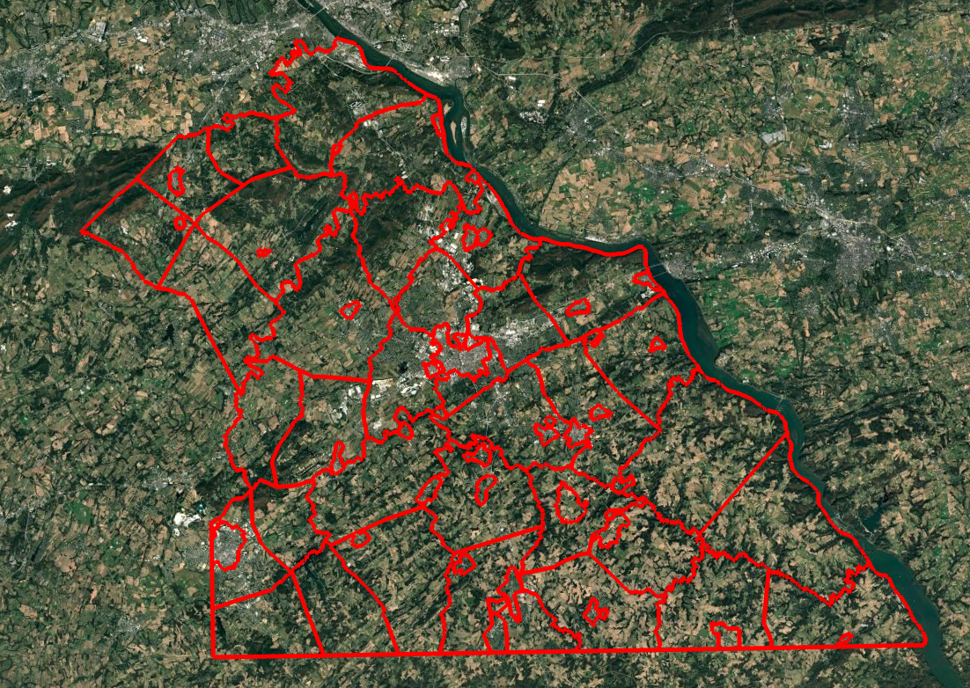

Slide 38
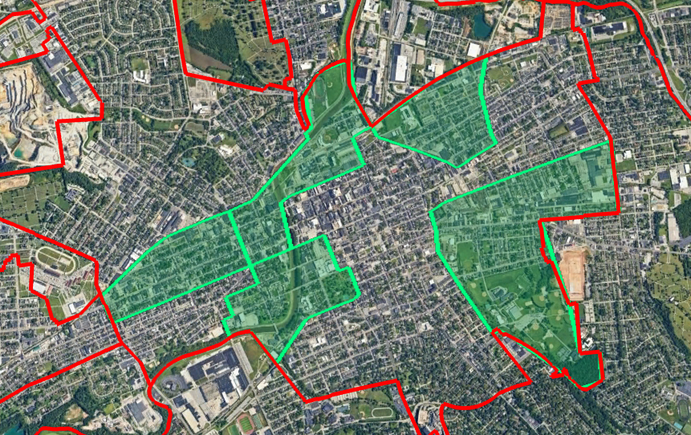

Slide 39
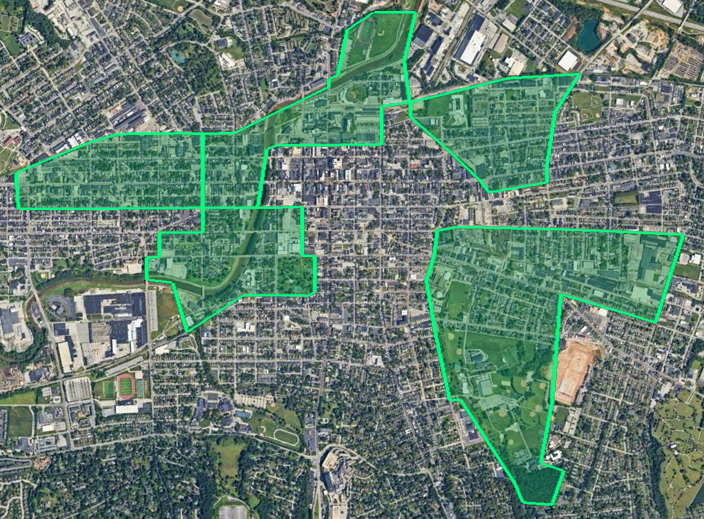

Slide 40
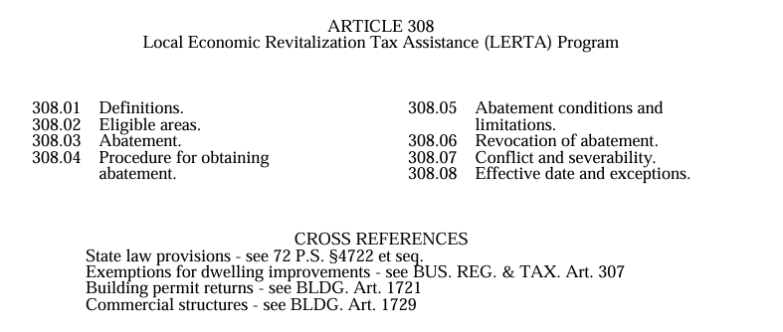

Slide 41
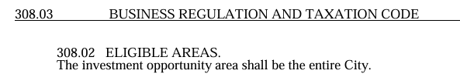
LERTA (Local Economic Revitalization Tax Assistance)
Provides for a 10% abatement of property taxes on improvements annually
Applies to commercial improvements
Applicable to City, School and County taxes

Slide 42



Slide 43
ReTAP
Provides for a 10% abatement of property taxes on improvements annually
Applies to residential improvements
Applicable to School and County taxes
City Taxes on improvements are abated for 10 years by 100%

Slide 44
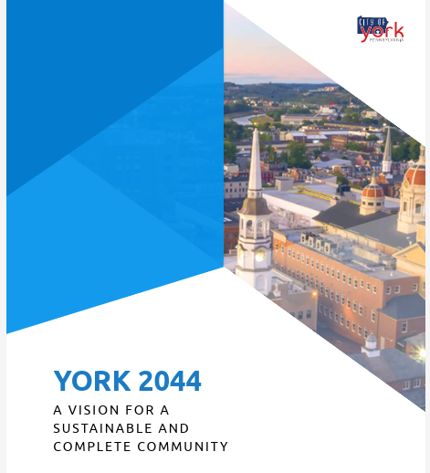

Slide 45
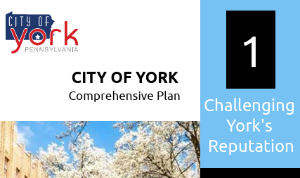

Slide 46
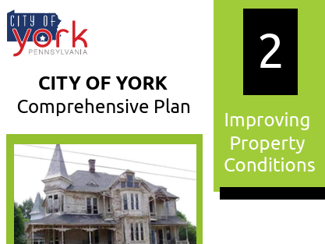

Slide 47
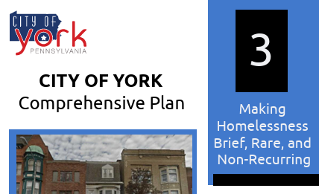

Slide 48


Slide 49


Slide 50


Slide 51


Slide 52
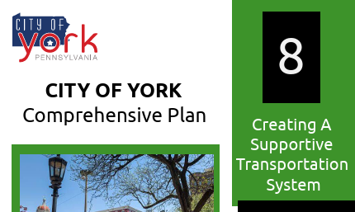

Slide 53


Slide 54
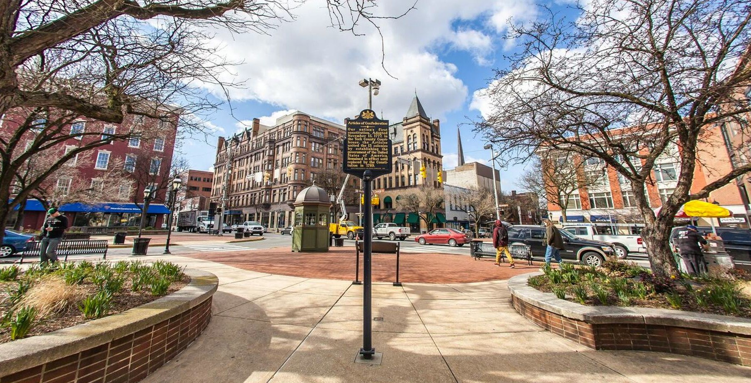


York County
Housing Study
2023 Data & Next Steps
Women in Commercial Real Estate
September 18, 2025
Brendan Salyards
Manager, Economic Initiatives & Analysis

Slide 55
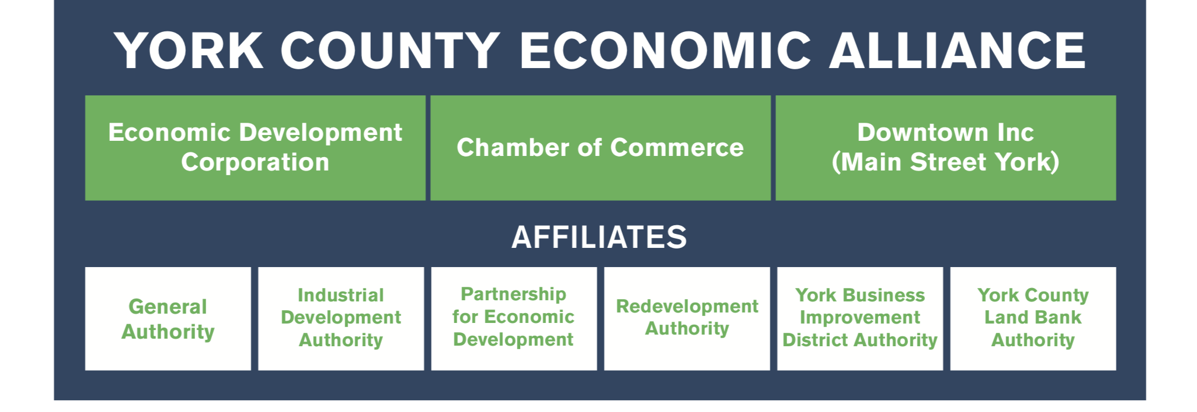
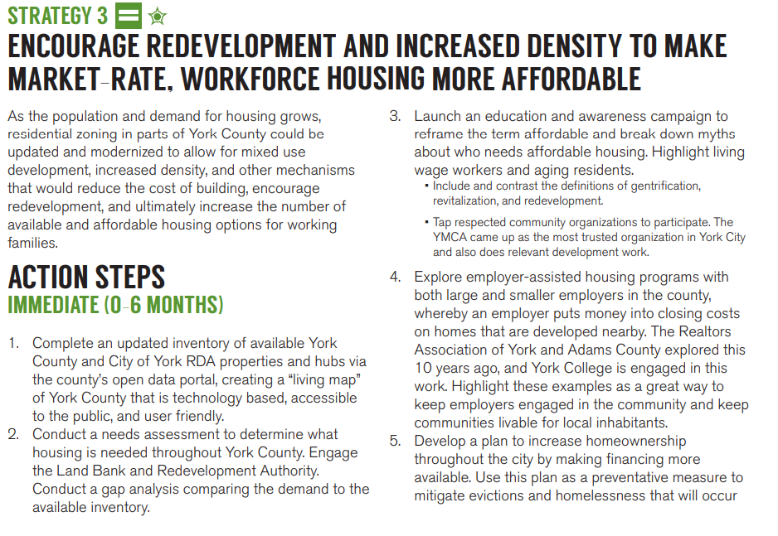
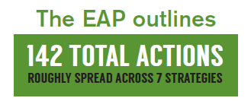
YCEA and Economic Action Plan
Notes:
Future of Industry
Workforce and Education
Entrepreneurship
Equity and Economic Mobility
Quality of Place
Infrastructure/Built Environment
Rural Economy

Slide 56
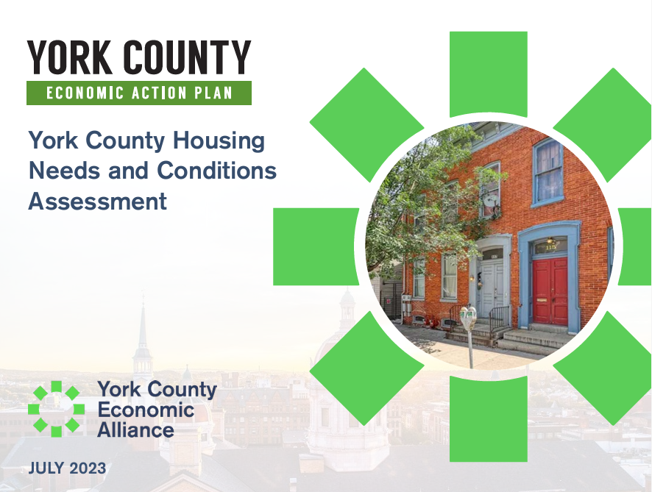
Countywide Housing Study
Two Phase Process
Phase 1:
  Convene steering committee
  Gather baseline data
  Promote
Phase 2:
  Identify existing collaboratives and initiatives, as well as gaps
  Develop and promote agenda of key initiatives to support housing partners
  Advance new initiatives where appropriate

Slide 57
Key Findings
Source: US Census.gov, American Communities Survey, 5-year Estimates

Slide 58
Key Findings
Source: US Census.gov, American Communities Survey, 5-year Estimates

Slide 59
Key Findings
Source: US Census.gov, 2023: American Communities Survey, 5-year Estimates

Slide 60
Key Findings
Source: US Census.gov, American Communities Survey, 5-year Estimates

Slide 61
Key Findings
Source: US Census.gov, 2023: American Communities Survey, 5-year Estimates

Slide 62
Key Findings
Source: Redfin.com

Slide 63
Key Findings
Source: Redfin.com
Notes:
$305 is the median sale price in July 2025 / 3% increase from 2024.
The highest increase in all of York is Spring Grove SD - at 34% ($322.5K)

Slide 64

Housing Action Agenda
Create a simple list of priority actions on tangible issues we can truly influence.
Project a whole-market approach to housing intervention.
Allow stakeholders to speak with one voice about shared priorities.
Guide funders and policymakers to key initiatives.
Empower stakeholders to leverage the agenda and advance their own goals.
Notes:
Renters:
to afford the county average apartment, a household must make nearly $50K yearly.
Rental property owners in the county have said they must charge higher rents so that building is financially feasible with the rising costs of construction. Furthermore, the lack of rentals reduces competition, making it easier to charge higher rents. With a lower rental vacancy (3.4 percent) than the state (5.1 percent), York County has a tighter rental market. All of this contributing in to cost burdened rental households.
Median Household:
At the end of 2022, the average sale price of homes was $245K for countywide and $119K for the city.
As of December 2023, the average countywide monthly rental price is $1,094 and $943 for the city.
Age:
The barrier to homeownership or living on their own for this age group remains prevalent
Lancaster:
- This is an adage the previous slide, of the new residents 85% of whom are aged 50 to 64 years old.
- York County is a growing destination for residents in our neighboring counties. This is the first time in recent data that Lancaster County sends more residents than they receive from York.

Slide 65
Priority Actions – Emergency & Stable Housing
1. Support the York County Stable Housing Collaborative’s goal to develop a permanent day shelter in the City of York through strong advocacy to funders and other stakeholders, with the goal of providing essential services and comfort to community members experiencing housing insecurity.
  Support for vulnerable populations is a key need and our community’s ability to support seniors, residents with physical or mental disabilities, those with substance use disorders, and those who are experiencing homelessness or history of evictions.
  The Beacon Center, established in the City of York in 2025.
  Led by York County Stable Housing Collaborative, Partner Supported

Slide 66
Priority Actions – Affordable Housing & Program Education
2. Collaborate with Affordable Housing Advocates, York Housing Authority, LifePath, and other applicable affordable housing partners to advance goals, including creating a tenant vetting program for developers, identifying landlords willing to do affordable housing set- asides, or accept Section 8 vouchers, and expanding communications to officials on existing challenges in funding programs.
  Support a continuum of care and the attainable housing partners through informed servicing of clients, to reduce revolving door and create an improved guide on the suite of services.
  Improving the understanding and communication of the broader pool of available resources aimed at supporting clients, including emergency services, financial planning, pathways to home and ownership.
  Led by Multiple Partners, Partners Supported

Slide 67
Priority Actions – Construction Workforce
3. Launch the Whole Home Repair training program, in partnership with the York County Planning Commission, to create pathways to in-demand construction careers and grow the capacity of the builder community for home rehabilitation and maintenance of existing building stock.
  A multi-faceted action step to address existing contractor limitations, improve feasibility of renovating the existing housing stock, and aid access to job secures to family sustaining wages.
  First course completed as of August 2025, 12 graduates.
  Wait list of 75, in anticipation of 2 more courses in the Fall and Winter.
  YCEA and YCPC Led, Partner Supported

Slide 68
Priority Actions – Municipal Planning
4. Support the York County Planning Commission (YCPC) to implement the federal PRO Housing Grant aimed at municipal outreach and education, with the goal of promoting missing middle housing through zoning reform and model ordinances that help address housing barriers.
  Opportunity to provide sample ordinances and templates for municipality consideration, across York County. This action would require review of best practices and research to develop the recommendations suitable for individual municipalities.
  Pivoted to a local government playbook to advance local policy solutions for the innovation in housing.
  Led by YCPC, Partner Supported

Slide 69
Priority Actions – Countywide Housing Developers Roundtable
5. Launch a quarterly Housing Developers Roundtable to provide a forum for information sharing and issue identification amongst the broad residential development and construction community.
  An opportunity for the range of developers to meet and discuss best practices, challenges, and engage in planning discussions as it is applied to addressing York County’s overall housing needs.
  A roundtable made up of public and private developers can lead to discussions for partnerships and as a tool to review recommendations from other priority action areas.
  YCEA Led, Partner Supported

Slide 70
Priority Actions – Employer Engagement
6. Formalize discussions of employer-invested workforce housing and home ownership incentives through Welcoming Workplaces.
  Over the next five years jobs are projected to increase by more than five thousand. With employers noting a challenge of hiring prospective employees is their ability to find adequate housing, this challenge may only be exacerbated if job growth continues but housing growth does not.
  Employers could support their own employees, or prospective candidates, through implementing policies that lead to investing in workforce housing or creating incentives.
  YCEA Led, Partner Supported

Slide 71
Kim Hogeman
YCEA
AVP, Economic & Community Development
Blanda Nace
City of York Redevelopment Authority
Executive Director
Brendan Salyards
YCEA
Manager, Economic Initiatives & Analysis
  Questions?

